Slide 1
Claflin University
Department of Energy
National Nuclear Security Administration
November 9, 2010
Presented by:
Nankwanga Cherry, NNSA Program Coordinator
Veronica Goodman, Co PI

Slide 2
Current NNSA Project
“Claflin University Program for the Preparation of a Technologically Literate Science Workforce to Meet the Needs of the 21st Century”
Dr. George E. Miller, III
Principal Investigator

Slide 3
Project Summary
This project was established as a technology training pipeline in engineering and bioengineering as a means to meet the national need for a technologically literate science and engineering workforce for this century.

Slide 4
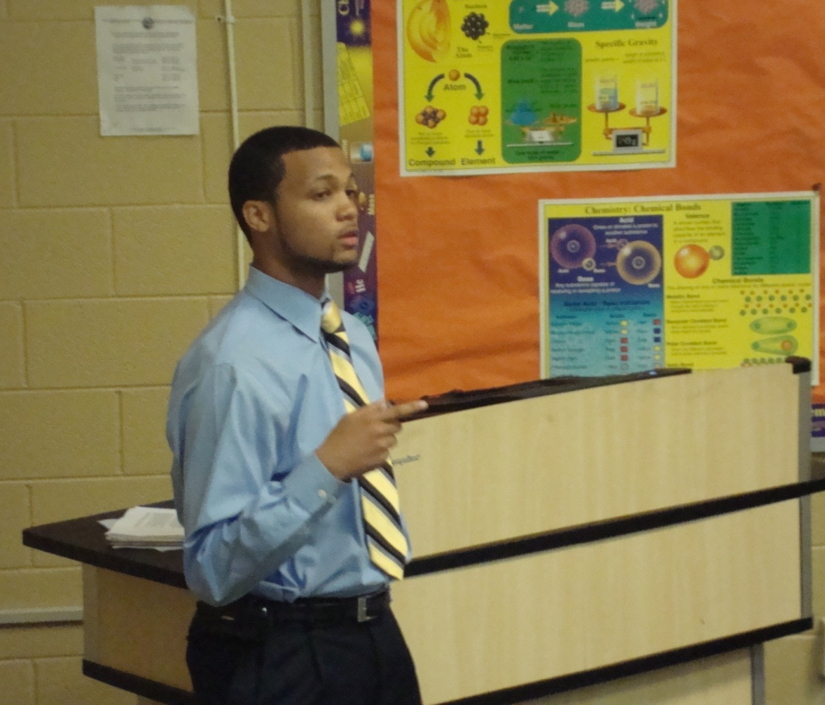
Areas of Focus
NNSA Funds are used to:
Provide Scholarships to Honor Students in the Sciences
Provide Research Assistantships, Laboratory Assistantships, research, teaching and lab supplies to help augment training and retention
Provide Equipment

Slide 5
Areas of Focus
Provide funds to market the bioengineering and engineering programs at Claflin to K-12 and BS degree students on a national level
Provide Faculty Release time for faculty in the School of Natural Sciences and Mathematics
Provide Summer Science Camp for Incoming Claflin Freshmen

Slide 6
SCHOLARSHIPS
Scholarships are provided for use in recruiting students into the School of Natural Sciences and Mathematics.
Approximately 120 students are provided full or partial scholarships for the fall semester.
Approximately 120 students are provided full or partial scholarships during the spring semester.
Approximately fifteen students are provided lab or research assistant positions in Chemistry, Mathematics and Computer Science.

Slide 7
FACULTY RELEASE
Faculty release funds are provided for eight faculty members in the School of Natural Sciences and Mathematics.

Slide 8
MARKETING OF PROGRAM
The School of Natural Science and Mathematics continues to market the bioengineering and engineering programs, with an emphasis on those in computer science, physical sciences, mathematics and engineering, at Claflin to K-12 and BS degree students on a national level through:
Newspaper Ads
Magazine Ads
Television Commercials, and
Billboard Advertising

Slide 9
SUMMER SCIENCE ENRICHMENT PROGRAM
The Summer Science Enrichment Program is held during the months of June and July. The program provides additional opportunities to recruit underrepresented minority students into the science, engineering and mathematics careers in general, and more specifically to Claflin’s undergraduate programs in these disciplines.

Slide 10
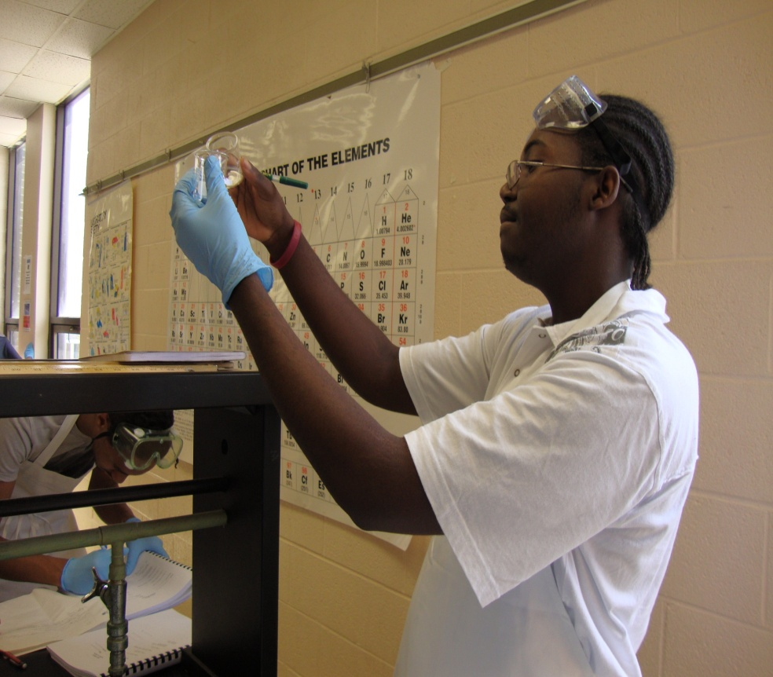
SUMMER SCIENCE ENRICHMENT PROGRAM
Matriculating freshmen at Claflin University
Natural Sciences, Mathematics, and Engineering majors
Six weeks
Students are enrolled in General Chemistry and Pre Calculus courses

Slide 11
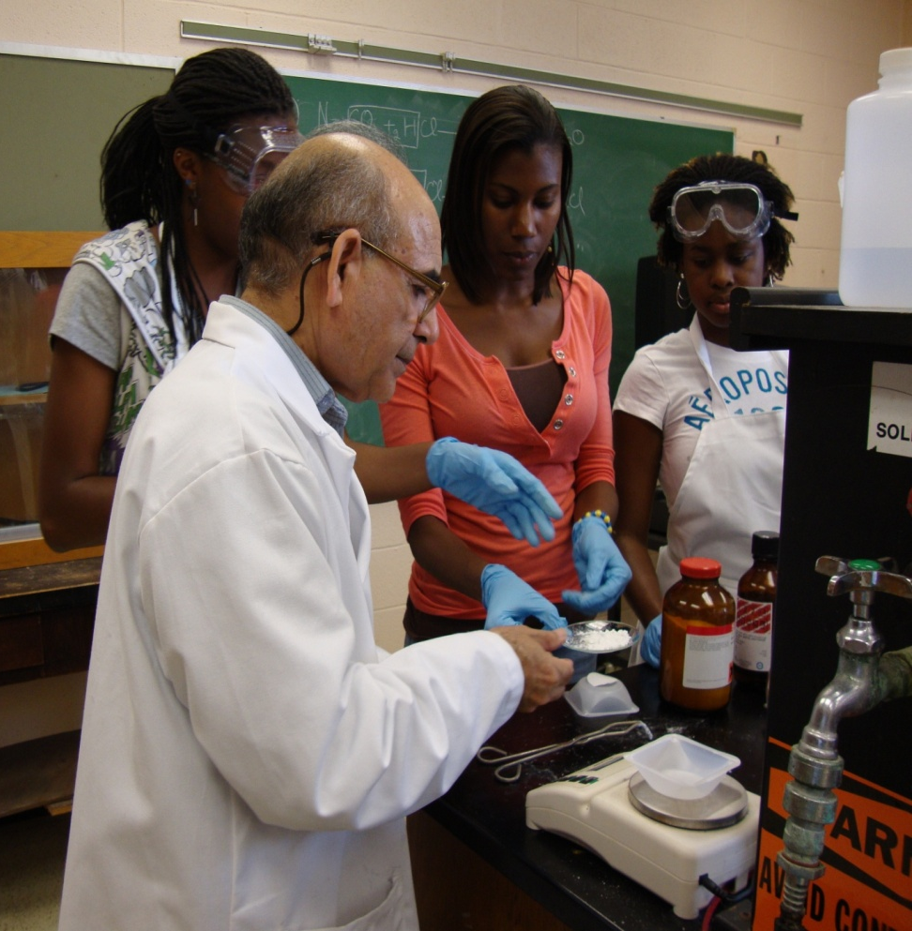
SUMMER SCIENCE ENRICHMENT PROGRAM
Additional Program Supports
Laboratory
Recitation
Supplemental Instruction
Individual Tutoring
Instructors’ Office Hours

Slide 12
SUMMER SCIENCE ENRICHMENT PROGRAM
Educational Trips
Research Presentations
Guest Speakers
Professional Development Workshops

Slide 13
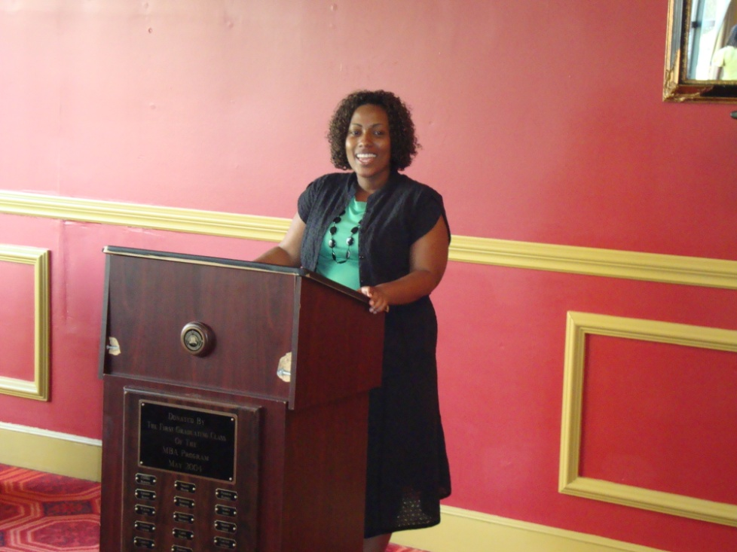
SUMMER SCIENCE ENRICHMENT PROGRAM
2010 Success Rate
86% Pre Calculus
(increased by 2% )
100% General Chemistry
(increased by 6% )
100% General Chemistry Lab

